Slide 1

GOVT. CHANDULAL CHANDRAKAR
P.G. COLLEGE PATAN DURG (C.G.)
TOPIC :-FUNCTION OF OPERATING SYSTEM
GUIDED BY
NIDHI SINGH THAKUR
SUBMITTED BY
KISHOR KUMAR

Slide 2
SYNOPSIS (संक्षेप/कथासार )
WHAT IS OPERATING SYSTEM
FUNCTION OF OPERATING SYSTEM
आईए जानते हैं ऑपरेटिंग सिस्टम के बारे में ………………?

Slide 3
WHAT IS OPERATING SYSTEM
OPERATING SYSTEM IS A SYSTEM SOFTWARE. WHICH PROVIDES INTERFACE BETWEEN USER AND HARDWARE.

Slide 4
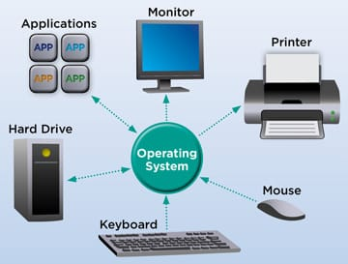

Slide 5
FUNCTION OF OPERATING SYSTEM
RESOURCE
MANAGEMENT
PROCESS
MANAGEMENT
MEMORY
MANAGEMENT
OPERATING
SYSTEM
STORAGE
MANAGEMENT
INPUT OUTPUT
MANAGEMENT

Slide 6
PROCESS MANAGEMENT:-
PROCESS MANAGEMENT MANAGE THE PROCESS MAIN MEMORY TO C.P.U. OR TERMINATE THE PROCESS
PROCESS LOAD MAIN MEMORY TO C.P.U. IS COLLED “C.P.U. SCHEDULING”
PROCESS
P1 PROCESS COME TO C.P.U. CCCC (P1) TERMINATE COMPLETE
(P2) T… COMPLETE ONE BY ONE
P2
P5
P1
MAIN MEMORY
C.P.U.
PROCESS MANAGEMENT
APPLICATION P1, P2

Slide 7
MEMORY MANAGEMENT :-
MEMORY MANAGEMENT MANAGE THE MEMORY SPACE OF MAIN MEMORY
IT ALLOCATE OR DEALLOCATE THE MEMORY SPACE OF MAIN MEMORY
ADDRESS NUMBER 2001
P
P
P1
2001
1
2
MEMORY

Slide 8
RESOURCE MANAGEMENT :-
RESOURCE MANAGEMENT MANAGE THE RESOURCE LIKE HARDWARE OR SOFTWARE
E.G. IF MULTIPLE USER ACCESSING THE SYSTEM SO RESOURCE MANAGEMENT HAS RESPONSIBILITY TO PROVIDE HARDWARE TO THE USER
FOR EXAMPLE:-
RESOURCE
SOFTWARE
SYSTEM (OS)
APPLICATION
CHROM
HARDWARE
INPUT
OUTPUT

Slide 9
STORAGE MANAGEMENT:-
STORAGE MANAGEMENT PROVIDE LOGICAL VIEW OF INFORMATION STORAGE
STORAGE MANGEMENT ABSTRACTS FROM THE PHYSICAL PROPERTIES
90% USE STORAGE
STORAGE LOGICAL VIEW

Slide 10

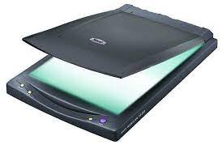
INPUT, OUTPUT MANAGEMENT :-
SCANNER
COMPUTER
INPUT
DEVICES
OUTPUT
DEVICES
KEYBORD
MONITER
CENTRAL PROCESSING UNIT
MOUSE
MUSIC
CONTROL
UNIT
ARITHMETIC
LOGIC UNIT
MEMORY
SPEAKER

Slide 11

THANK YOU…

